Slide 1
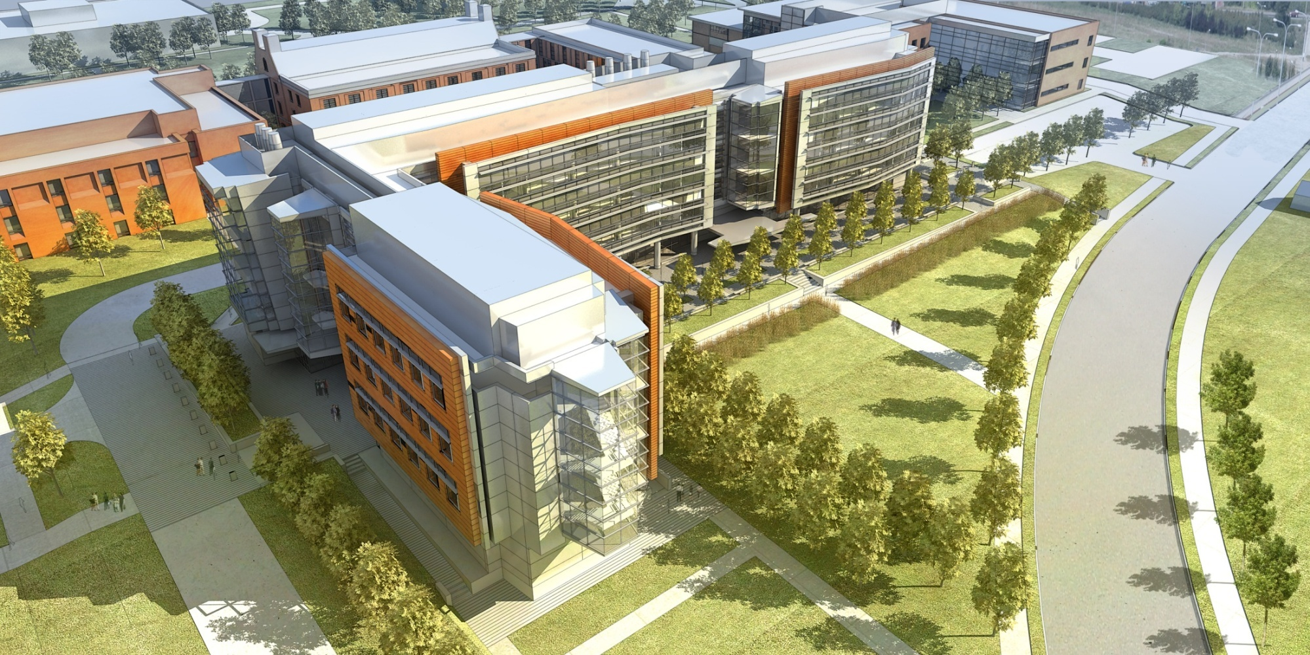
Chemistry & Chemical Biology Building, Busch Campus

Slide 2
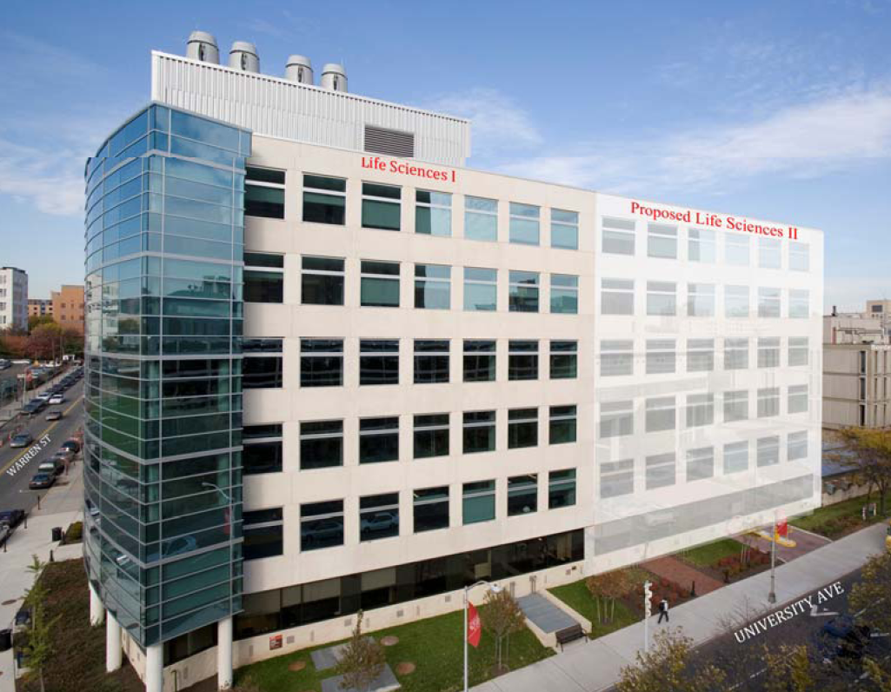
Life Science II Center, Newark Campus

Slide 3
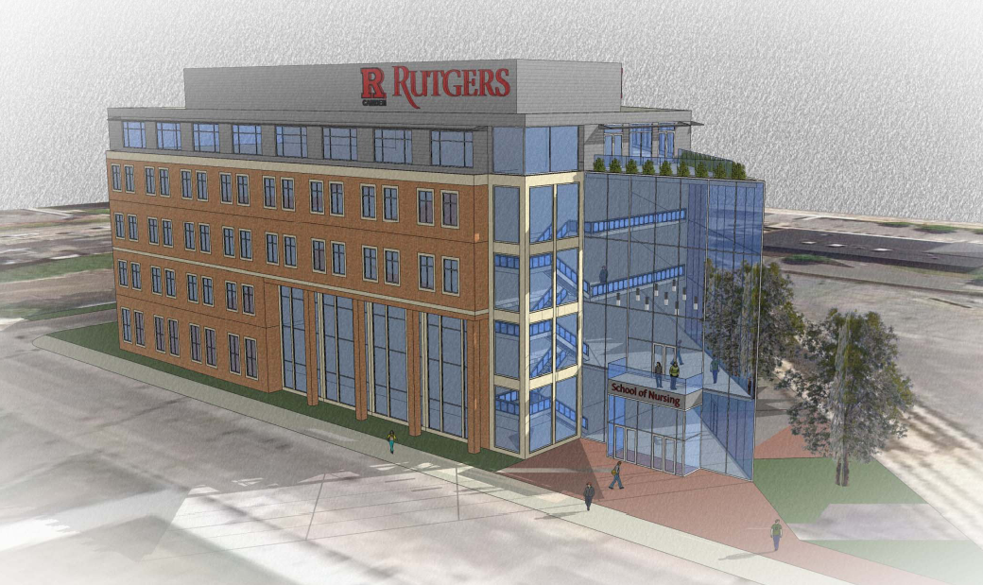
Nursing Science, Camden Campus

